Slide 1
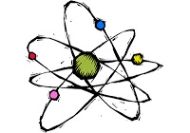
Chapter 8: Chemical Reactions and Physical Changes
Group Blue
Block 1

Slide 2
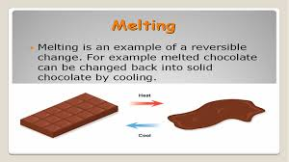
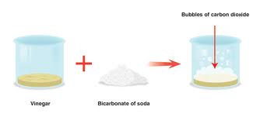
Objectives
Compare chemical reactions to physical changes
Compare parts of an atom
Calculate the mass of one mole of an element or compound
Explain how ionic and covalent bonds are formed
Identify the parts of chemical equations
Distinguish between reversible and irreversible reactions and changes

Slide 3
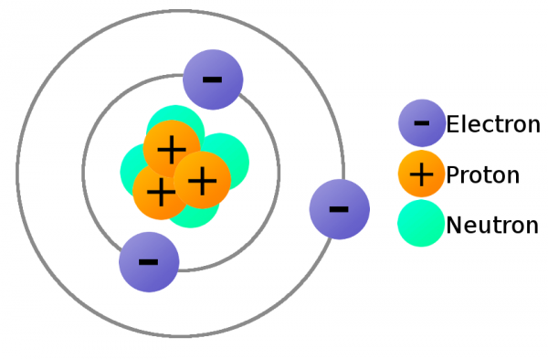
Vocab
Chemical reaction: the change of substances into other substances
Example: A candle’s wick catching fire
Video: http://www.youtube.com/watch?v=C5tOEBmBAHg
Physical change: an alteration of a substance that does not change its chemical composition
Example: Melting wax on a candle
Atomic number: the number of protons in an atom
Neutron: an uncharged atomic particle
Nucleus: the dense core of an atom
Video: http://www.youtube.com/watch?v=FooZ9AwPSG8
Protons: particle with a positive
electrical charge

Slide 4
Cont.
Electron: negatively charged particle that moves around the nucleus
Mass number: total protons and neutrons in an atom’s nucleus
Atomic mass: the average mass of a sample of atoms of that element found in nature
Periodic table: chart that arranges elements by atomic number into rows and columns according to similarities in their properties

Slide 5
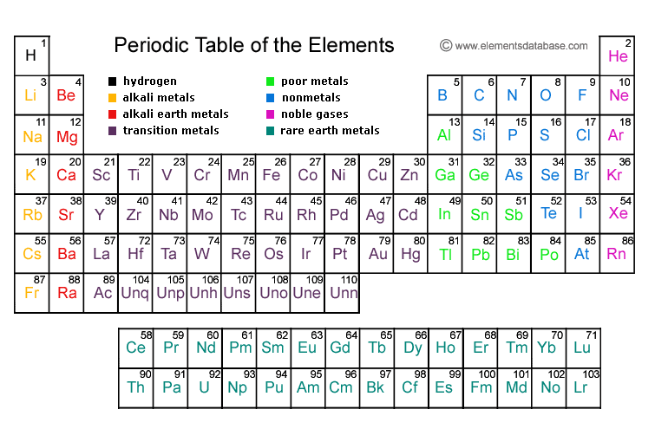
MASS NUMBER

Slide 6
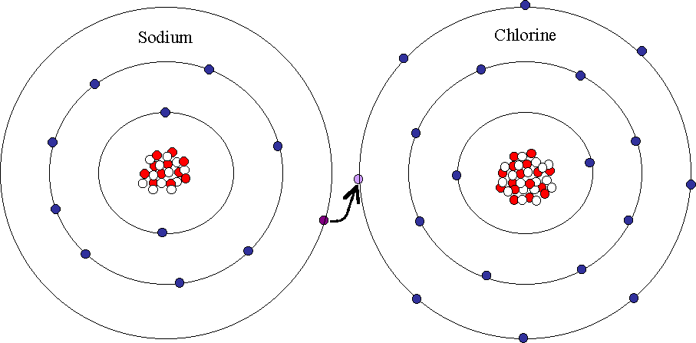
Cont.
Mole: the unit of measure used to count molecules or atoms
Equation: 6.02 * 10^23
Chemical bonds: the forces that hold atoms together
Ions: charged particles
Ionic bond: the bond formed by the transfer of electrons between atoms
Example: one metal and one nonmetal bonding
Ionic compounds: compounds that result when metals and non-metals bond ionically with each other
Covalent bond: atoms share electrons with each other
Example: two nonmetals bonding

Slide 7
Cont.
Chemical equation: written description of a chemical reaction using symbols and formulas
Reactants: the elements or compounds present at the start of a reaction
Products: the elements or compounds formed during the reaction
Covalent compounds: compounds formed by the sharing of electrons

